Slide 1

Bioinformatics Bootcamp
Biomedical Machine Learning with Python
PART II: Machine Learning for Biomedical Applications
Module 5: Getting to know your Data

Slide 2
Contact Info
Daniel Montemayor Ph.D.
Assistant Professor / Research
Center for Renal Precision Medicine
Department of Medicine
UT Health San Antonio
Email: montemayord2@uthscsa.edu
Office hours: https://calendly.com/daniel_montemayor/montemayor-office-hours

Slide 3
Part II : Overview
Getting to know your data
Formatting | Visualization | Partitioning | Normalization | Integrity
Feature Selection
Parsimony | Dimension Reduction | PLS-DA | t-SNE | SOM
Classification Models
Cross-Entropy and other Error Metrics | Random Forest | Logistic Regression
Regression Models
Linear Regression | Regularization | LASSO | Elastic-Net
End-to-End ML Workflow – Leukemia Project (two weeks)
Convolutional Neural Networks – MRI Brain Tumor Project
Adv. Topics – Sequence. Models | Encoders |GANs | Reinforcement Learning

Slide 4
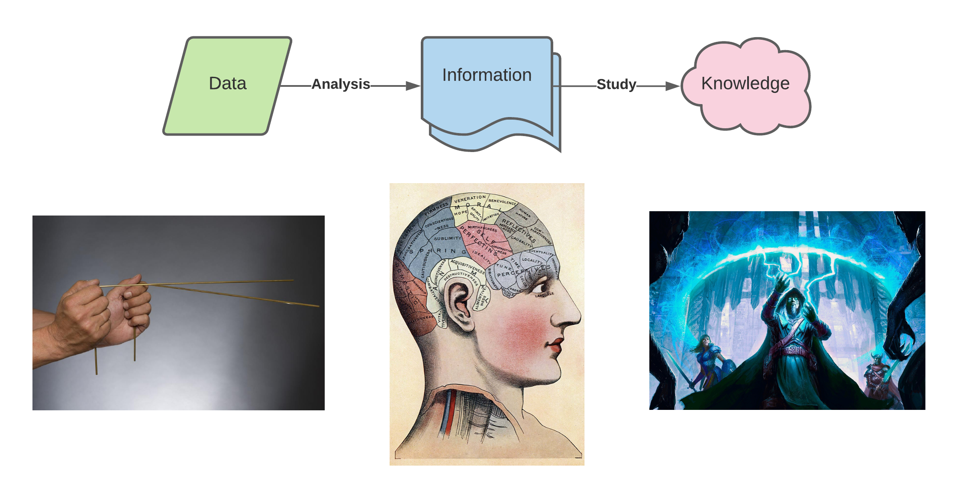
Distinguishing Data, Information, and Knowledge
Scientific Data are values obtained by measurement. -> Observations
Information is useful demonstrable facts about data. -> Relationships
Knowledge is inferred statements about how nature works. -> Applications

Slide 5
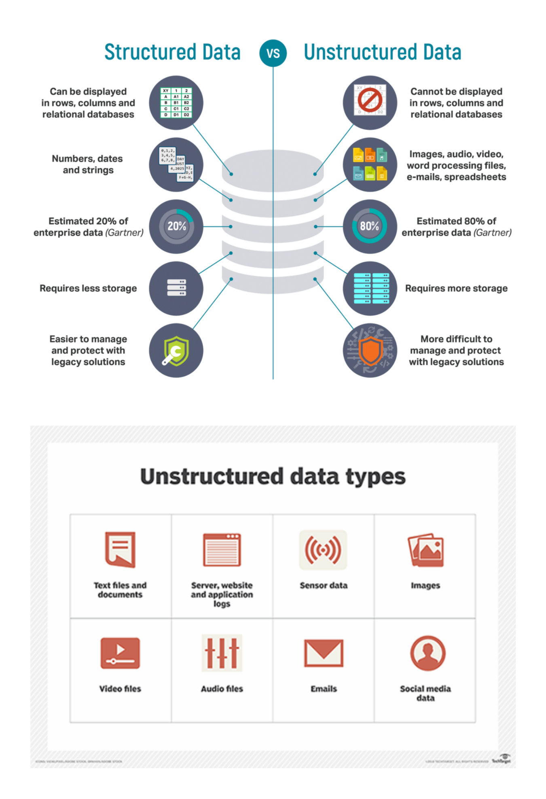
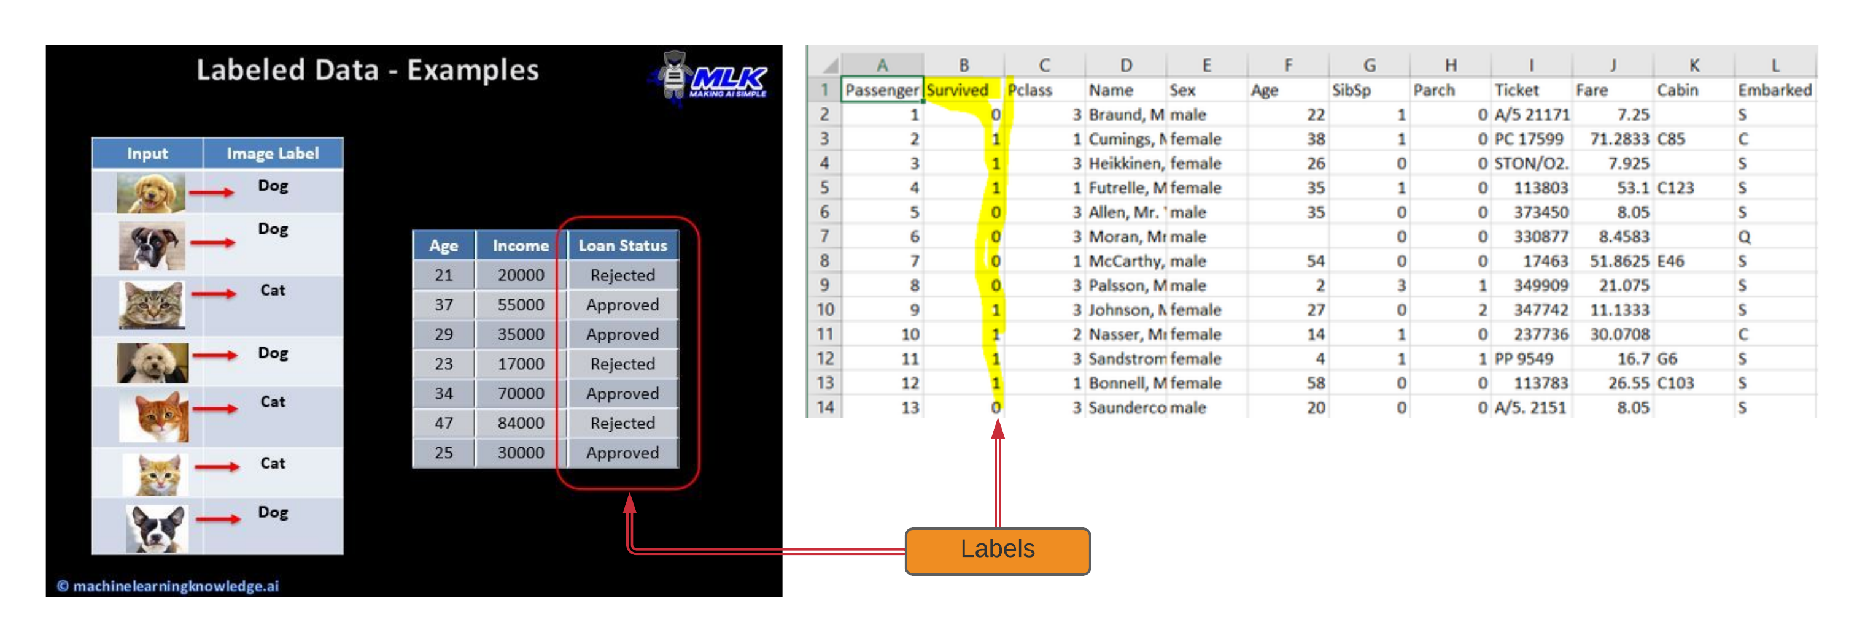
What is data?
Often visualized as observations and features in some spreadsheet. Structured
Most data is un-structured. (lab notes, numbers mixed with descriptive prose)
Sometimes observations are linked to known outcomes. Paired or Labeled data

Slide 6


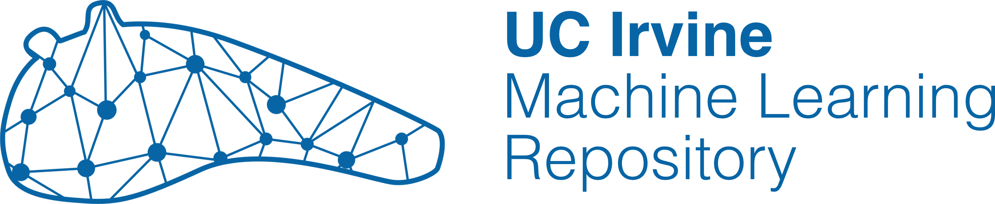
Fantastic Data and where to find them
https://www.kaggle.com/
http://www.ics.uci.edu/~mlearn/MLRepository.html
https://archive-beta.ics.uci.edu/
https://www.quandl.com/
Usual UX is to search databases by:
Task – Regression, Clustering, Classification
Domain – Life sciences, Physical sciences, Social sciences …
Size – Number of Observations, Features, or Outcomes

Slide 7
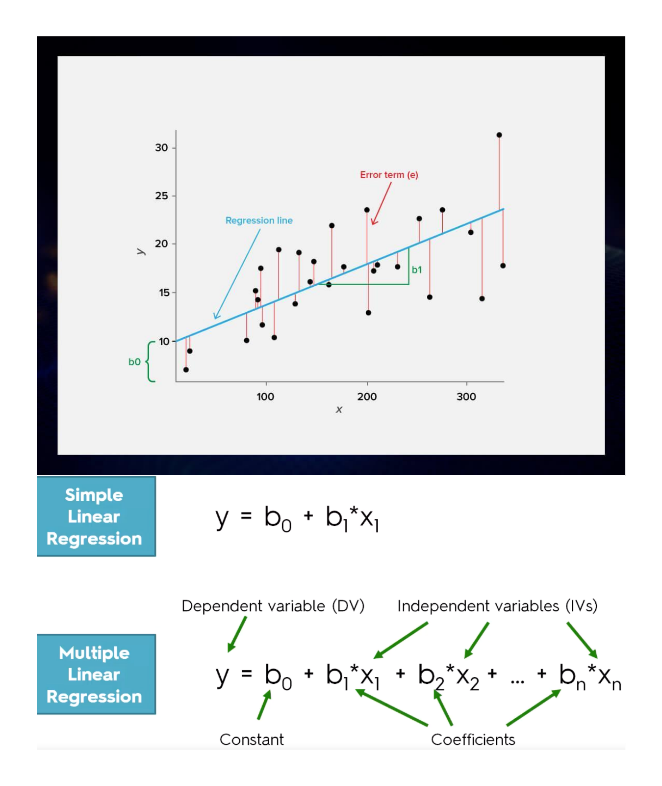
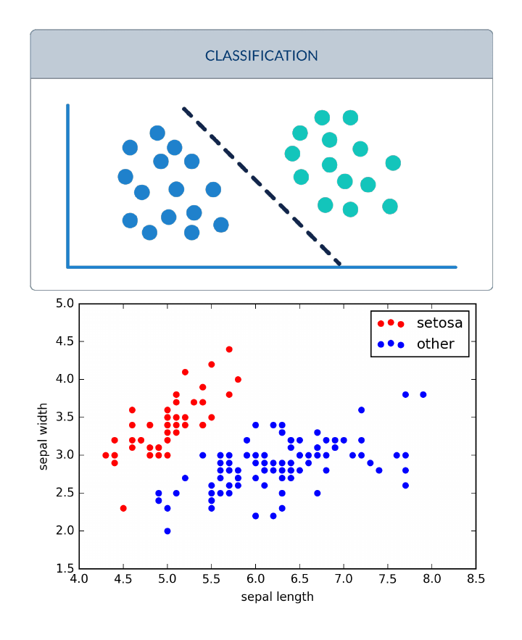
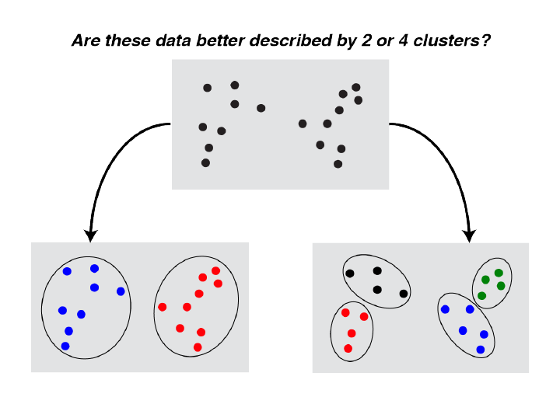
Regression, Classification, and Clustering
Continuous Paired Data
Categorical Labels
Unlabeled Data

Slide 8
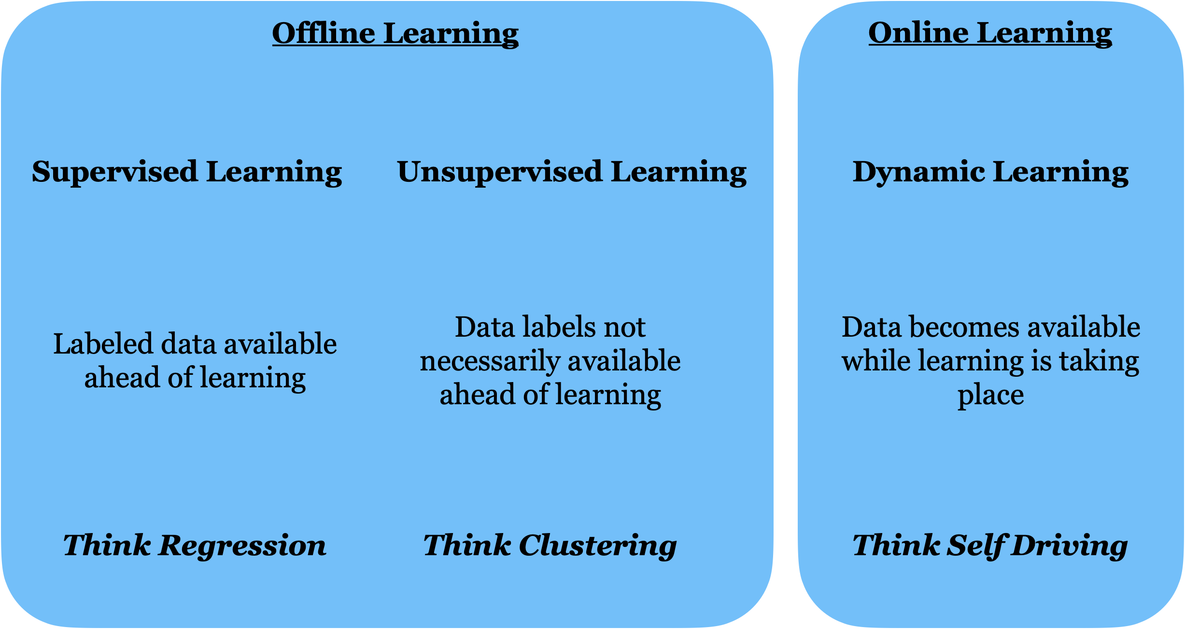
Types of Machine Learning

Slide 9
Autism screening in Children
Brief:
Autism spectrum disorder (ASD) is associated with life-long healthcare costs. This can be mitigated by early diagnosis. Meanwhile, rate of cases are increasing. Presently, very limited autism datasets associated with clinical or screening are available and most of them are genetic in nature. Hence, we propose a new dataset related to autism screening of adults that contained 20 features to be utilized for further analysis especially in determining influential autistic traits and improving the classification of ASD cases.
Dataset sourced from UCI ML archive:
https://archive.ics.uci.edu/ml/datasets/Autistic+Spectrum+Disorder+Screening+Data+for+Children++#
Relevant Papers:
Thabtah, F. (2017). Autism Spectrum Disorder Screening: Machine Learning Adaptation and DSM-5 Fulfillment. Proceedings of the 1st International Conference on Medical and Health Informatics 2017, pp.1-6. Taichung City, Taiwan, ACM.
Thabtah, F. (2017). ASDTests. A mobile app for ASD screening. www.asdtests.com [accessed December 20th, 2017].
Thabtah, F. (2017). Machine Learning in Autistic Spectrum Disorder Behavioural Research: A Review. To Appear in Informatics for Health and Social Care Journal. December, 2017 (in press)

Slide 10
Data description distributed along with data
Task: Classification
Attribute Type: Categorical, continuous and binary
Area: Medical, health and social science
Format Type: Non-Matrix
Does your data set contain missing values? Yes
Number of Instances (records in your data set): 292
Number of Attributes (fields within each record): 21
Relevant Information: For Further information about the attributes/feature see below table

Slide 11
Data description distributed along with data
Attribute | Type | Description
Age | Number | years
Gender | String | Male or Female
Ethnicity | String | List of common ethnicities in text format
Born with jaundice | Boolean (yes or no) | Whether the case was born with jaundice
Family member with PDD | Boolean (yes or no) | Whether any immediate family member has a PDD
Who is completing the test | String | Parent, self, caregiver, medical staff, clinician ,etc.
Country of residence | String | List of countries in text format
Used the screening app before | Boolean (yes or no) | Whether the user has used a screening app
Screening Method Type | Integer (0,1,2,3) | The type of screening methods chosen based on age category (0=toddler, 1=child, 2= adolescent, 3= adult)
Question 1 Answer | Binary (0, 1) | The answer code of the question based on the screening method used
Question 2 Answer | Binary (0, 1) | The answer code of the question based on the screening method used
Question 3 Answer | Binary (0, 1) | The answer code of the question based on the screening method used
Question 4 Answer | Binary (0, 1) | The answer code of the question based on the screening method used
Question 5 Answer | Binary (0, 1) | The answer code of the question based on the screening method used
Question 6 Answer | Binary (0, 1) | The answer code of the question based on the screening method used
Question 7 Answer | Binary (0, 1) | The answer code of the question based on the screening method used
Question 8 Answer | Binary (0, 1) | The answer code of the question based on the screening method used
Question 9 Answer | Binary (0, 1) | The answer code of the question based on the screening method used
Question 10 Answer | Binary (0, 1) | The answer code of the question based on the screening method used
Screening Score | Integer | The final score obtained based on the scoring algorithm of the screening method used. This was computed in an automated manner

Slide 12
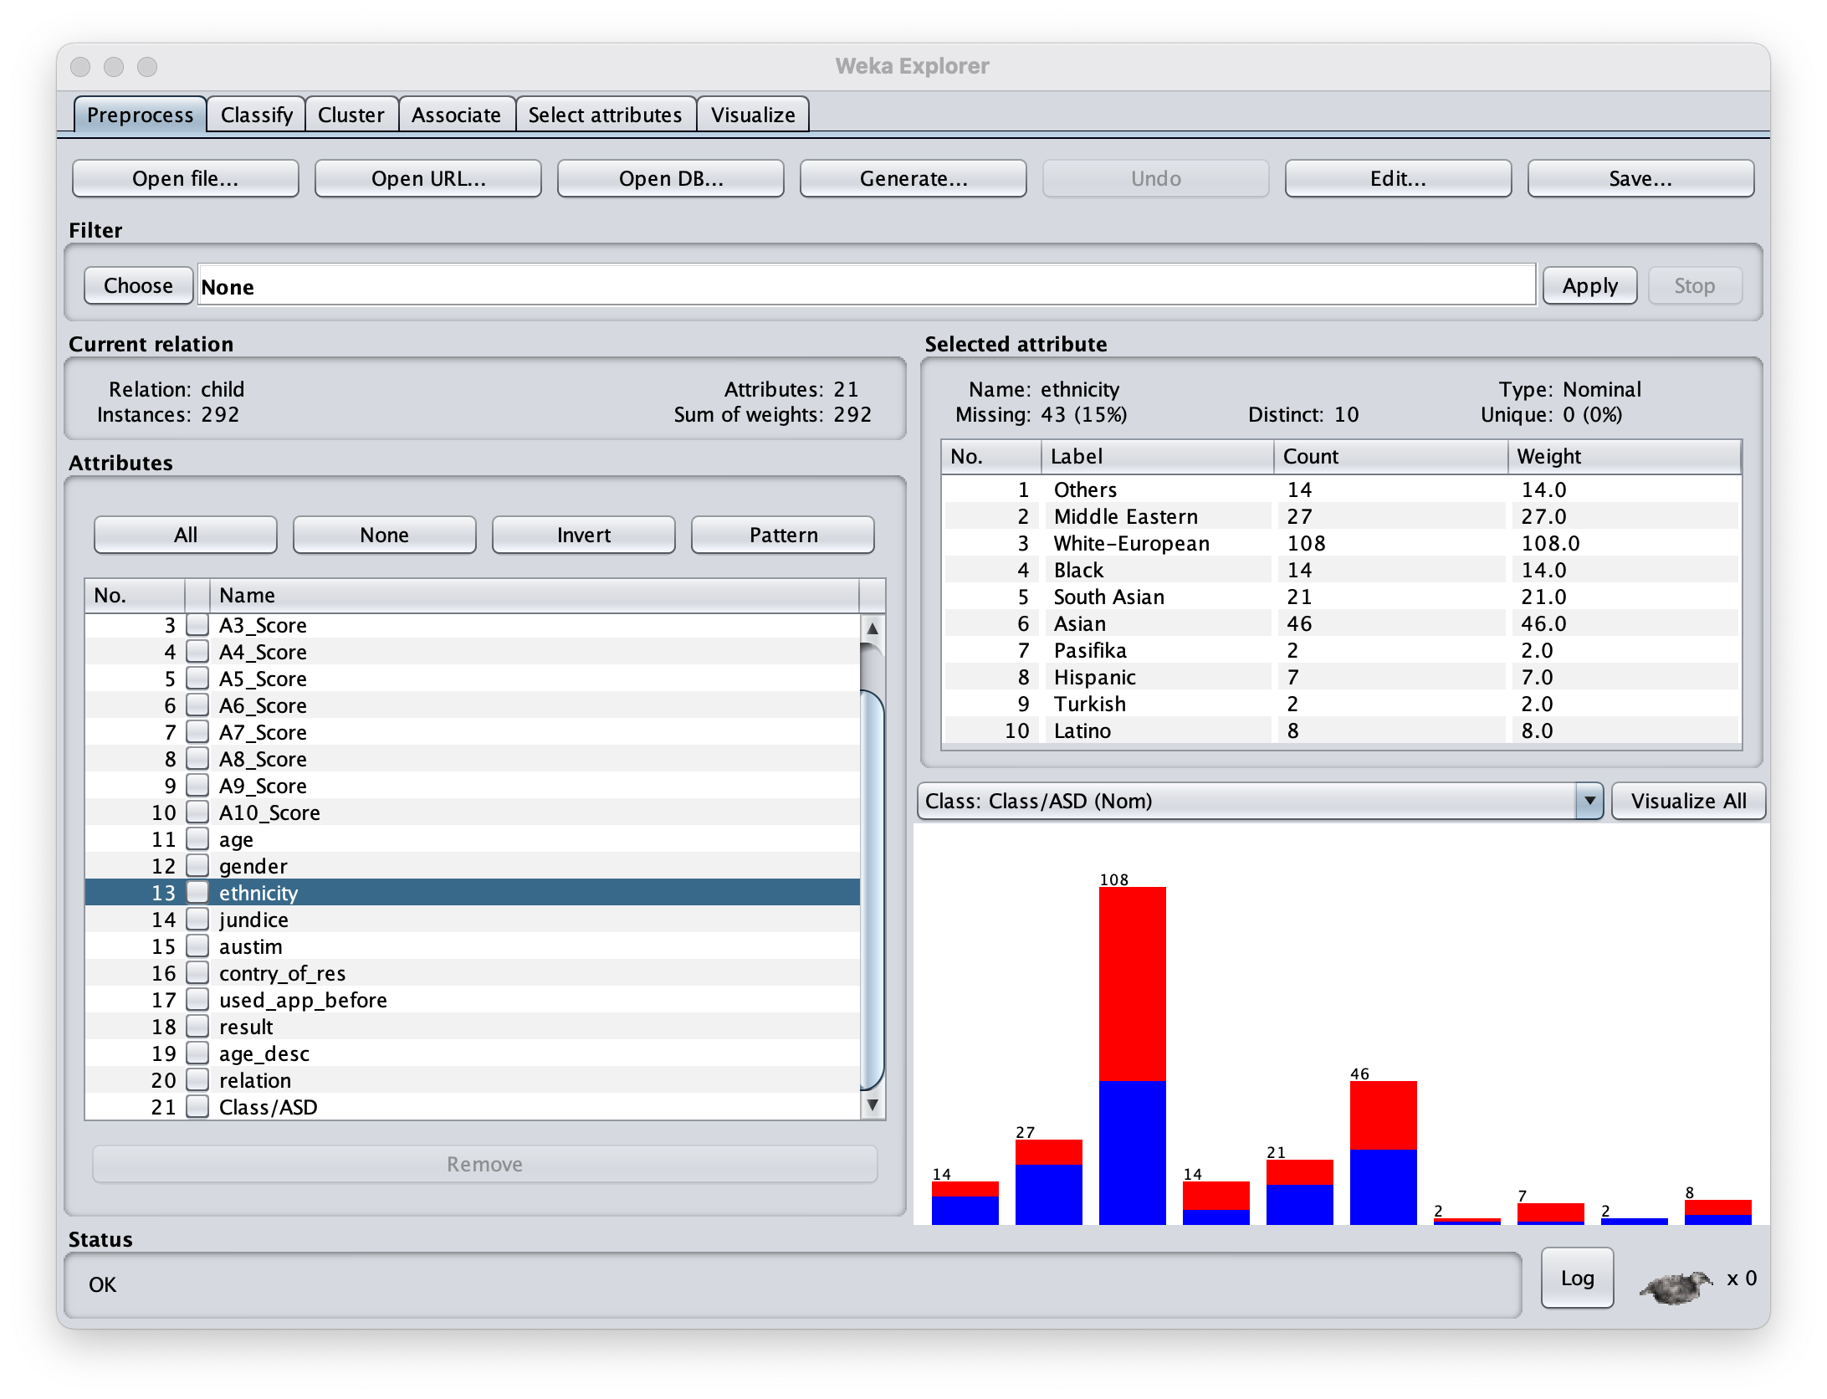

Weka for EDA
Download Weka here https://waikato.github.io/weka-wiki/downloading_weka/
Run explorer
Summarize feature (attributes) and view distribution by Label: (cases in red)
(ctrl in blue)
Label (Class) is always the last variable
Check out this great Weka tutorial by Google!
https://www.youtube.com/watch?v=TF1yh5PKaqI

Slide 13
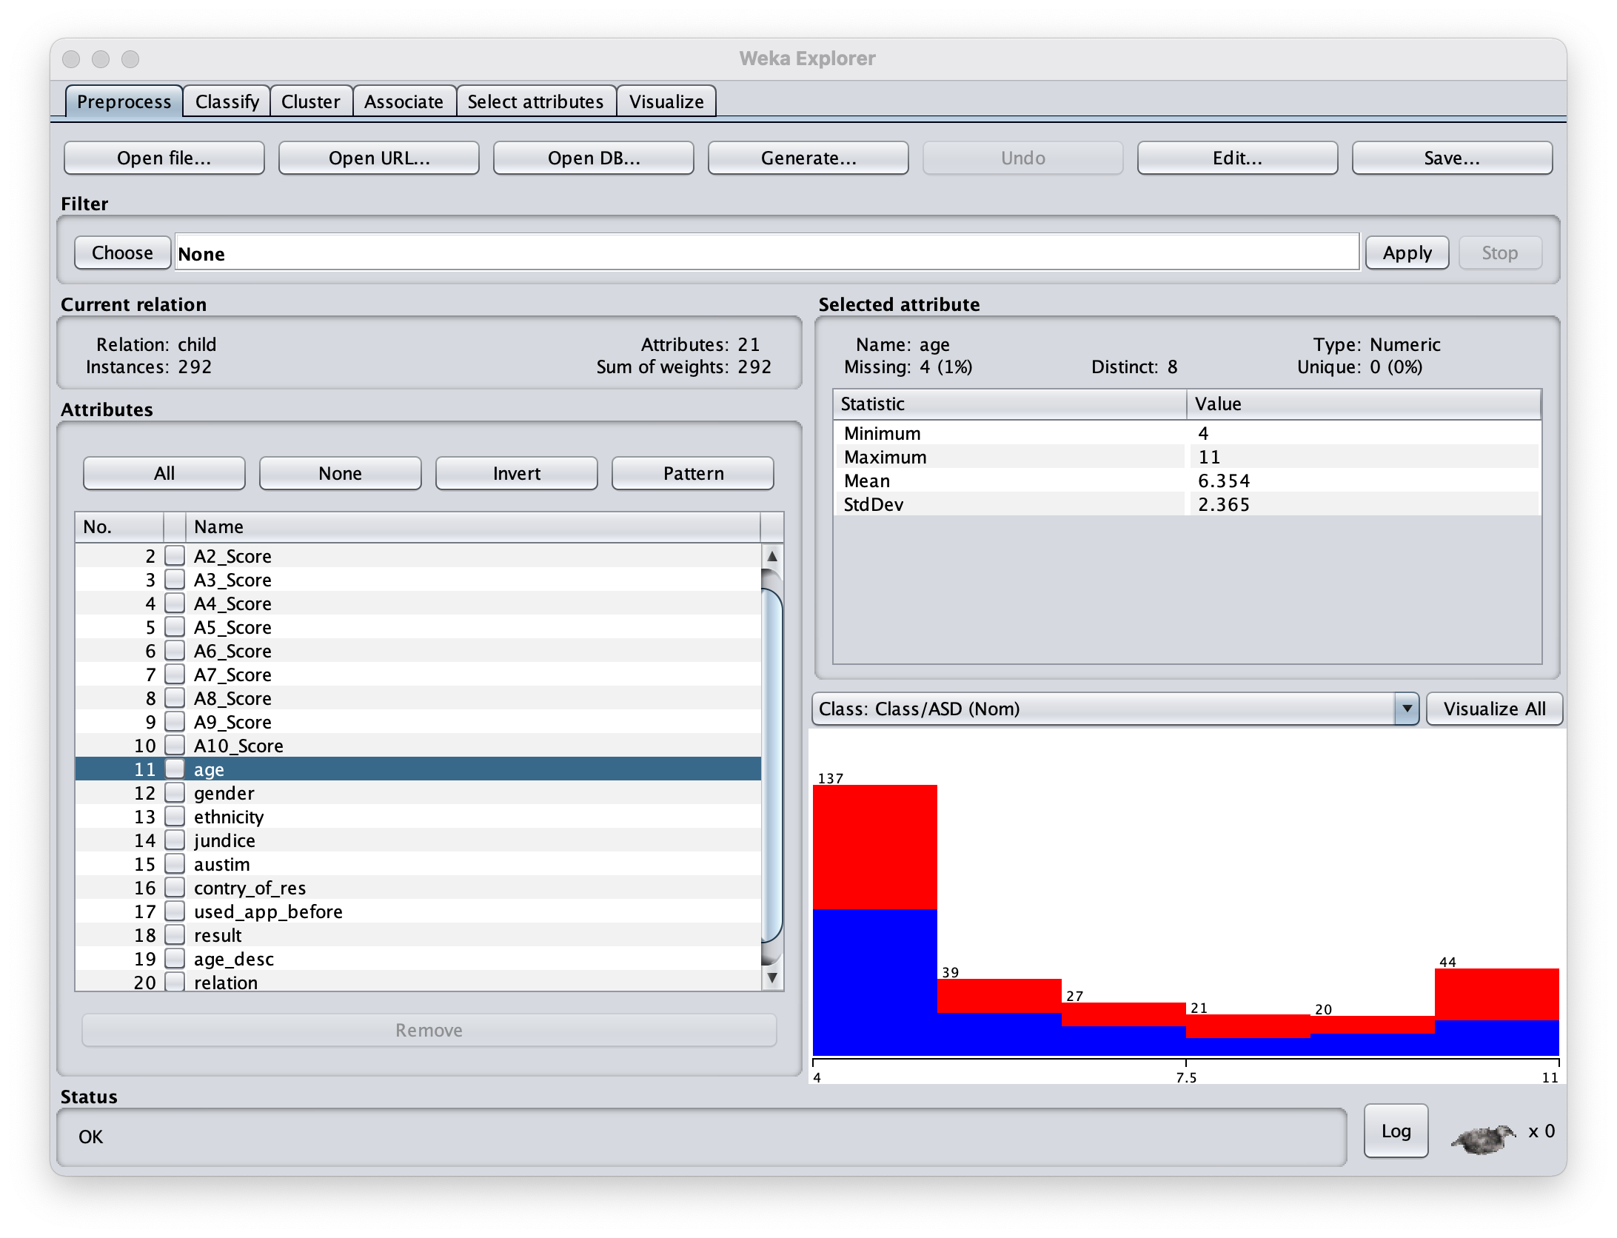
Weka for Exploratory Data Analysis
Let’s look at AGE
Looks like there are only 8 distinct ages.
No Age is unique.
4 Age values are missing.
Looks like prevalence of cases is 50% for all age groups.
Age groups are not normally or uniformly sampled.

Slide 14
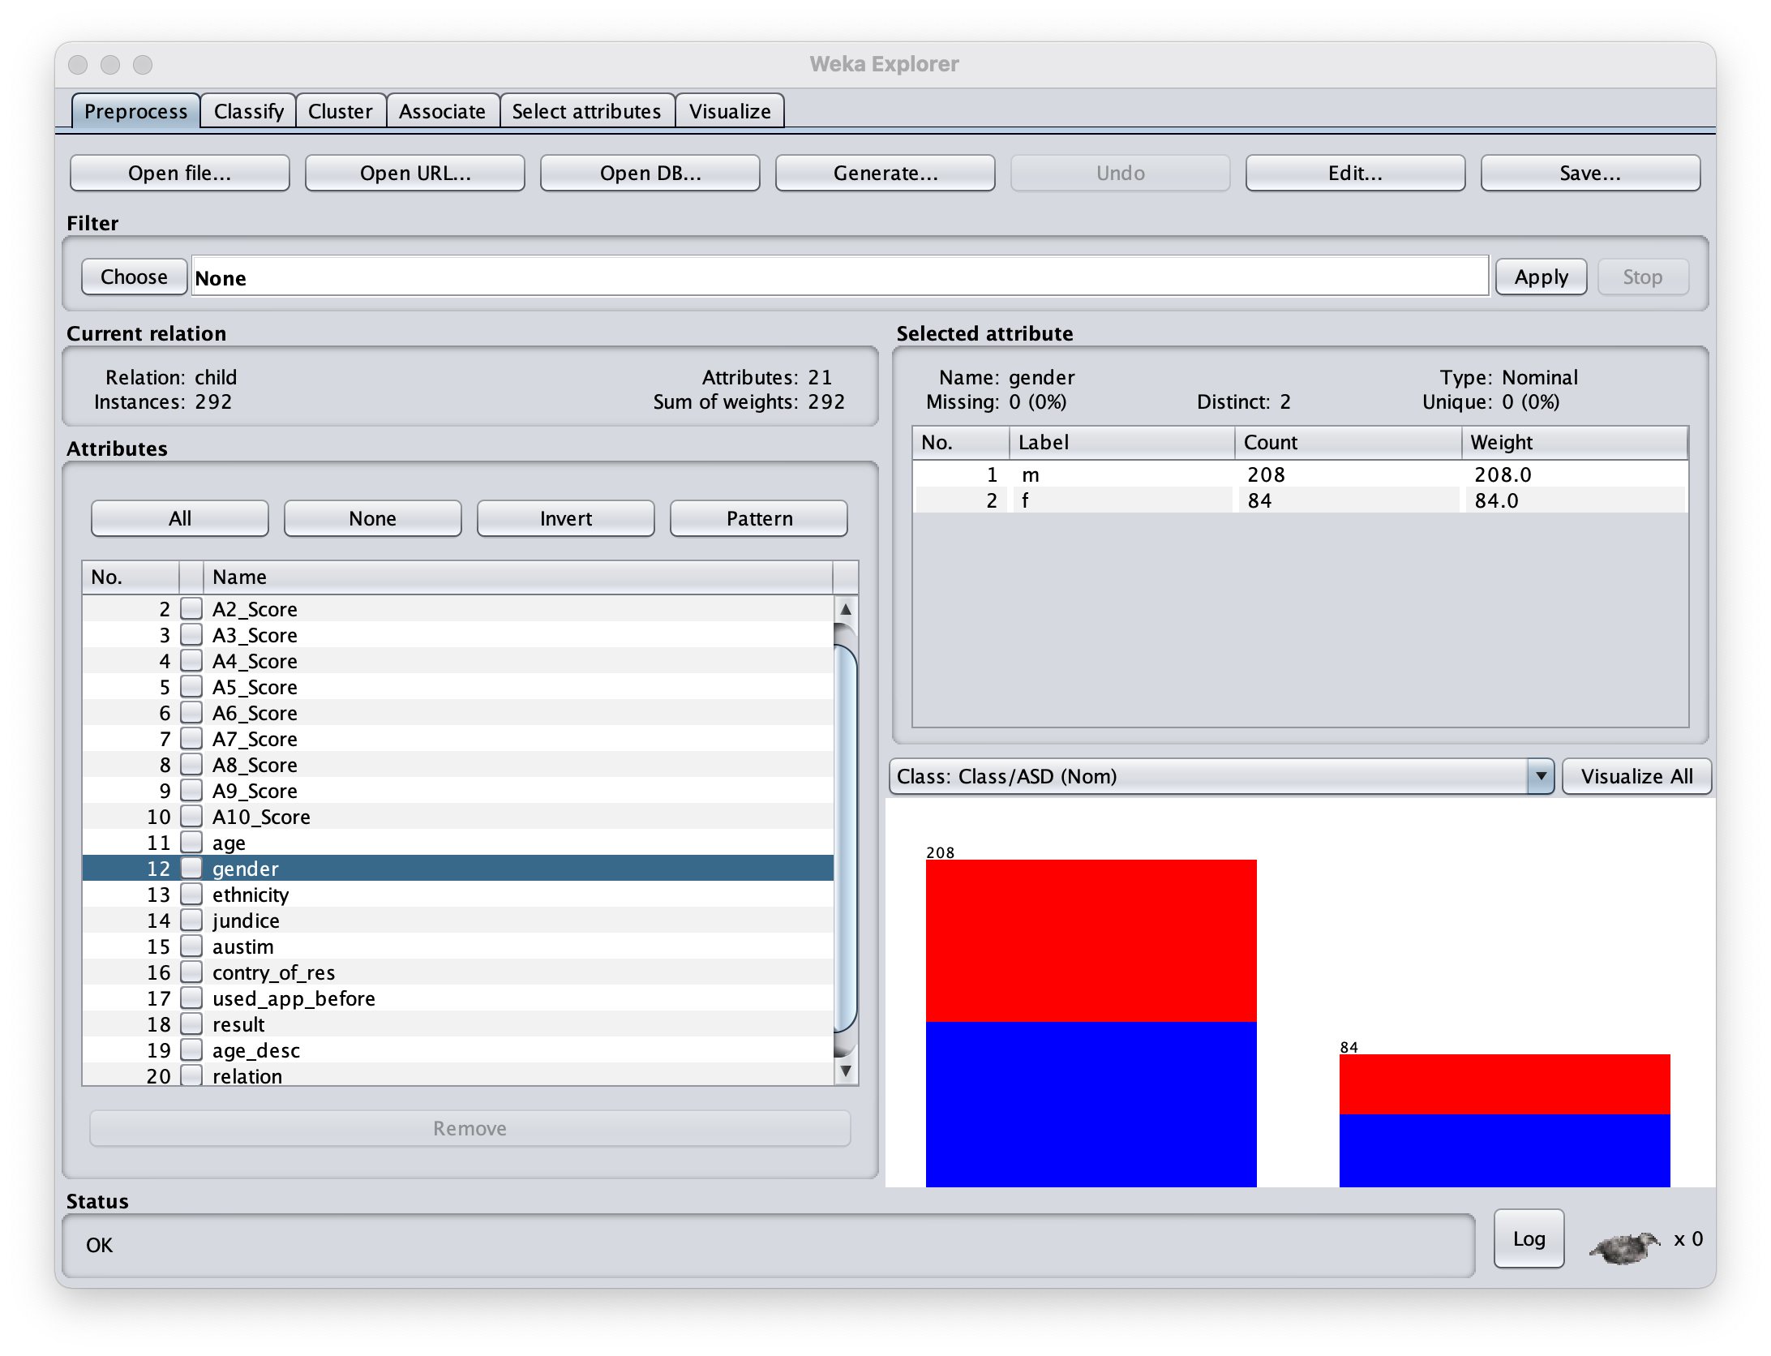
Weka for Exploratory Data Analysis
What about gender:
Twice as many Males as Females
Looks like prevalence of cases is 50% for both sexes.

Slide 15

Weka for Exploratory Data Analysis
And Ethnicity:
Looks like 10 ethnic groups are represented.
Ethnicity is unknown for 15% of patients.
Most patients are White.
Nearly all Hispanic patients are autistic.

Slide 16
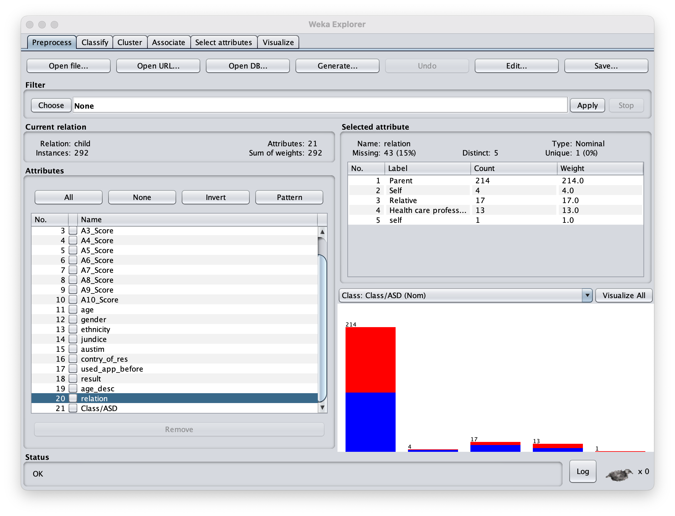
Weka for Exploratory Data Analysis
Why not, let’s look at who’s filling out the form:
Luckily only 5 groups
Most are Parents.
Ugh… ”self” and “Self”
And we don’t know who filled out 15% of the forms

Slide 17
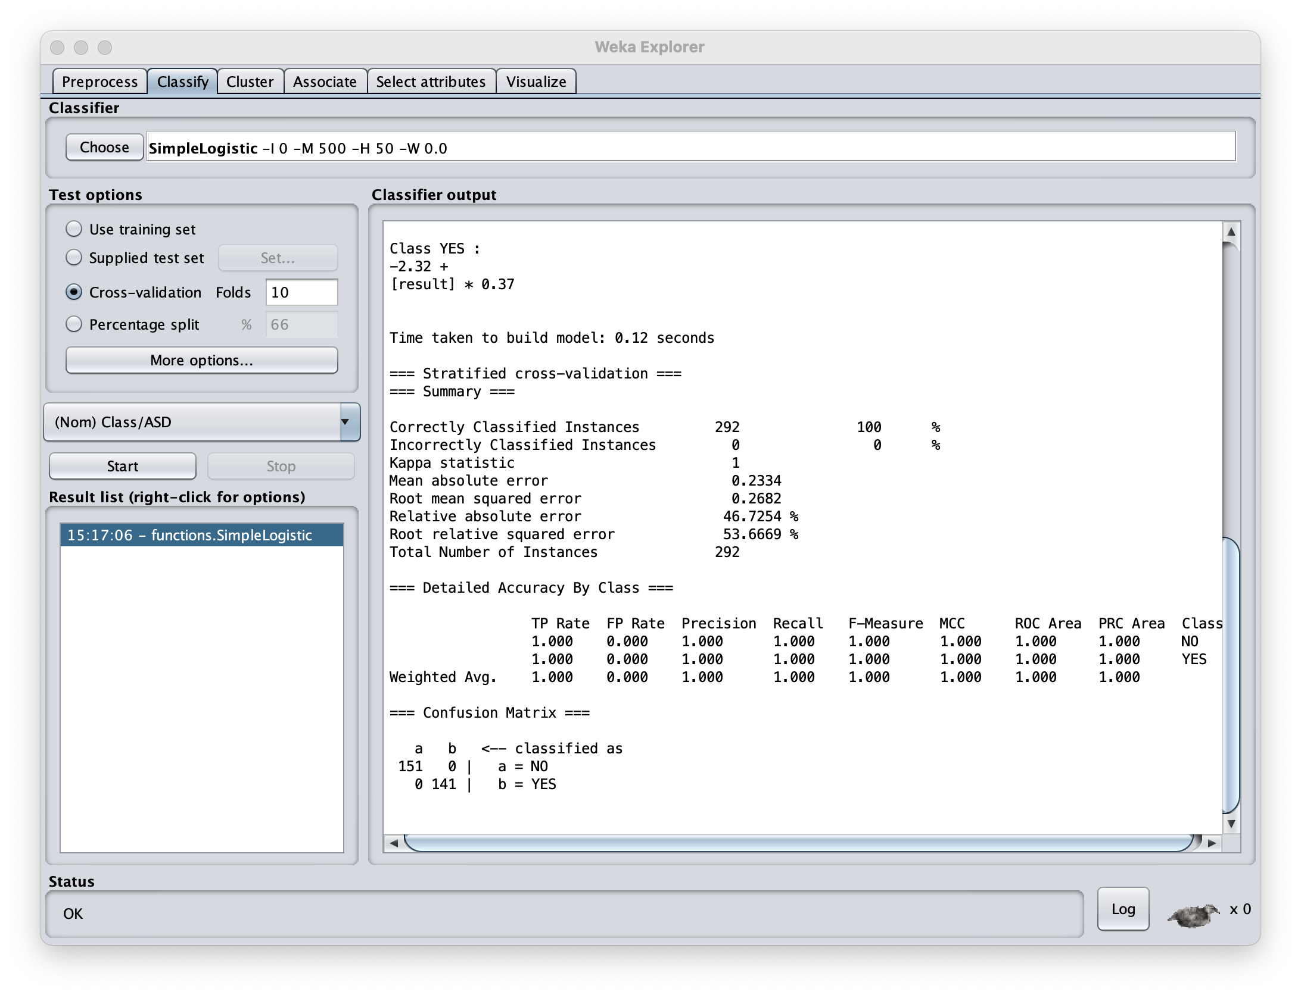

I’m too busy for EDA – just hit classify already
Let’s try some logistic regression to predict the binary Autism outcome:
SimpleLogistic will remove uninformative features and select the most predictive ones.
No way am I overfitting this – Let’s do 10-fold cross-validation

Slide 18
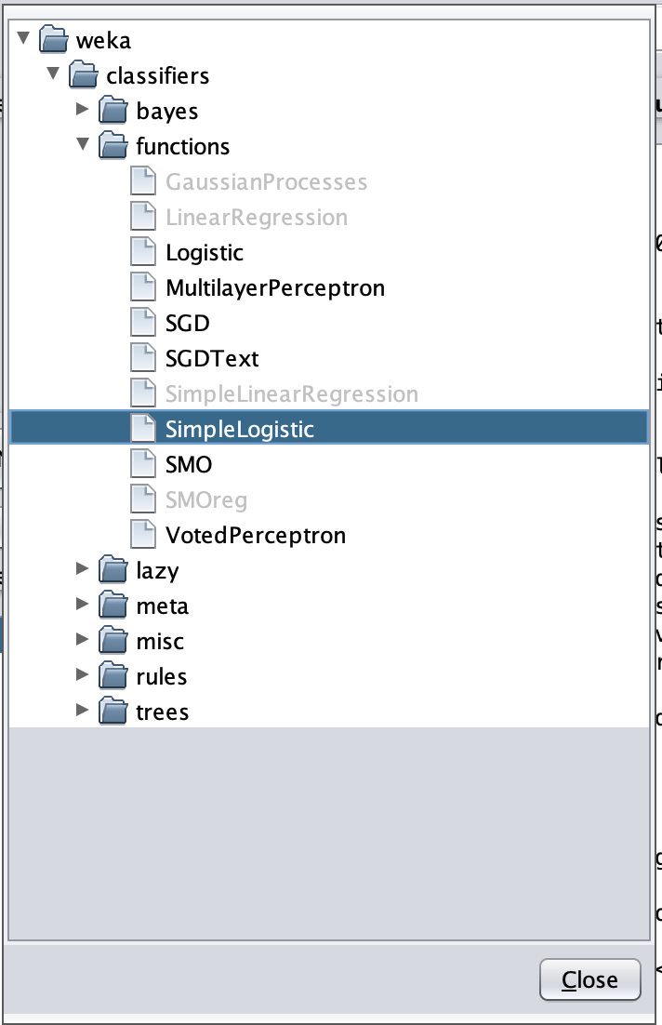
I’m too busy for EDA – just hit classify already
Click: choose -> classifiers -> functions -> SimpleLogistic

Slide 19
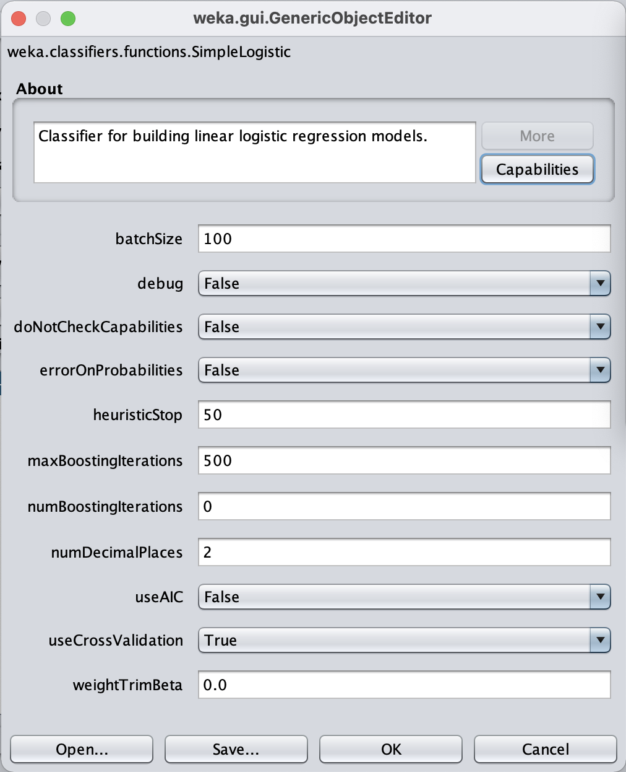
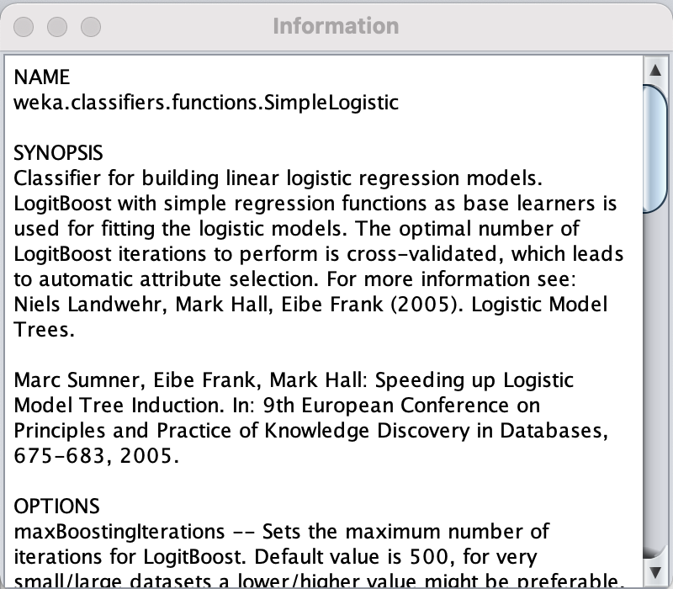
I’m too busy for EDA – just hit classify already
Click on “SimpleLogistic” to bring up the parameters window.
Then, click “More” to expand the About page to get a detailed description of the method.

Slide 20
I’m too busy for EDA – just hit classify already
Simple logistic Regression:
Booyah! Look at that confusion matrix
100% correctly classified Instances
This is the end of the analysis – scroll up to see more.

Slide 21
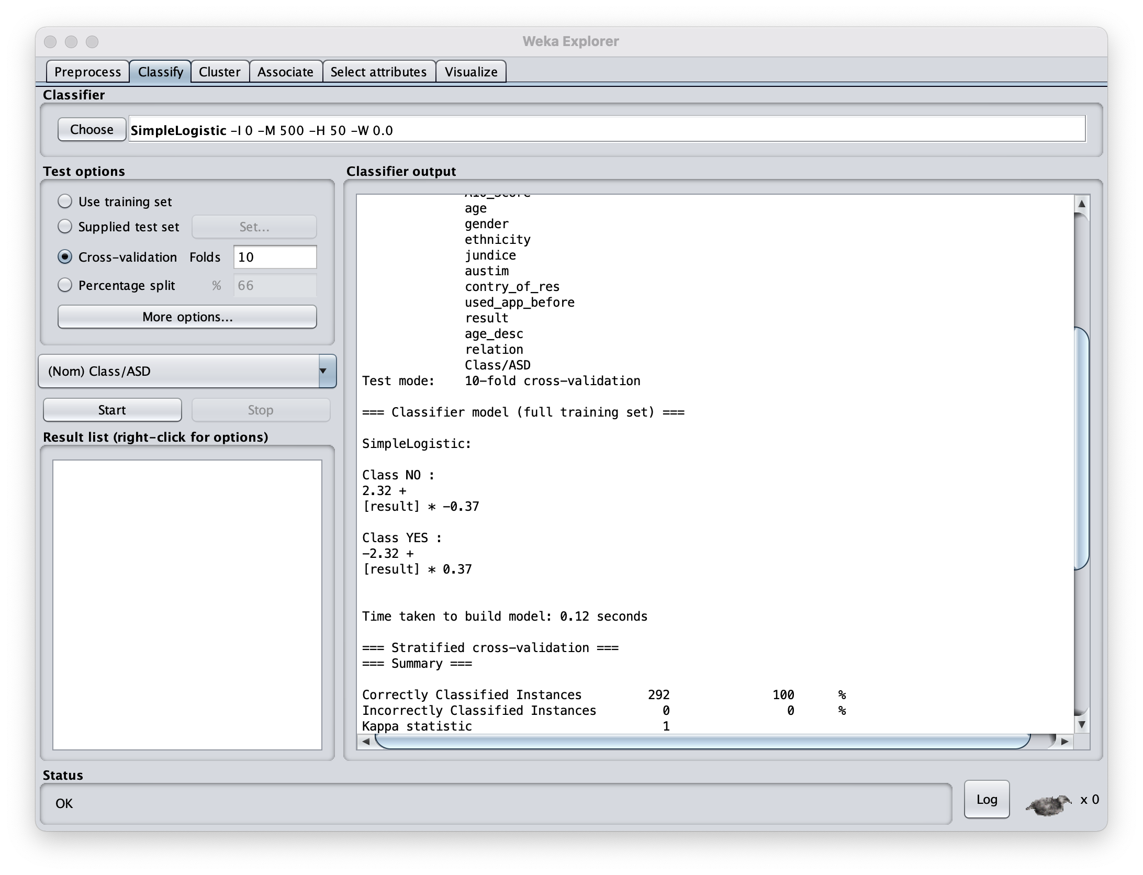
I’m too busy for EDA – just hit classify already
What are the important features:
The result variable for Class NO (ctrl outcome)?
And again the result variable for predicting Class YES (case outcome)?

Slide 22
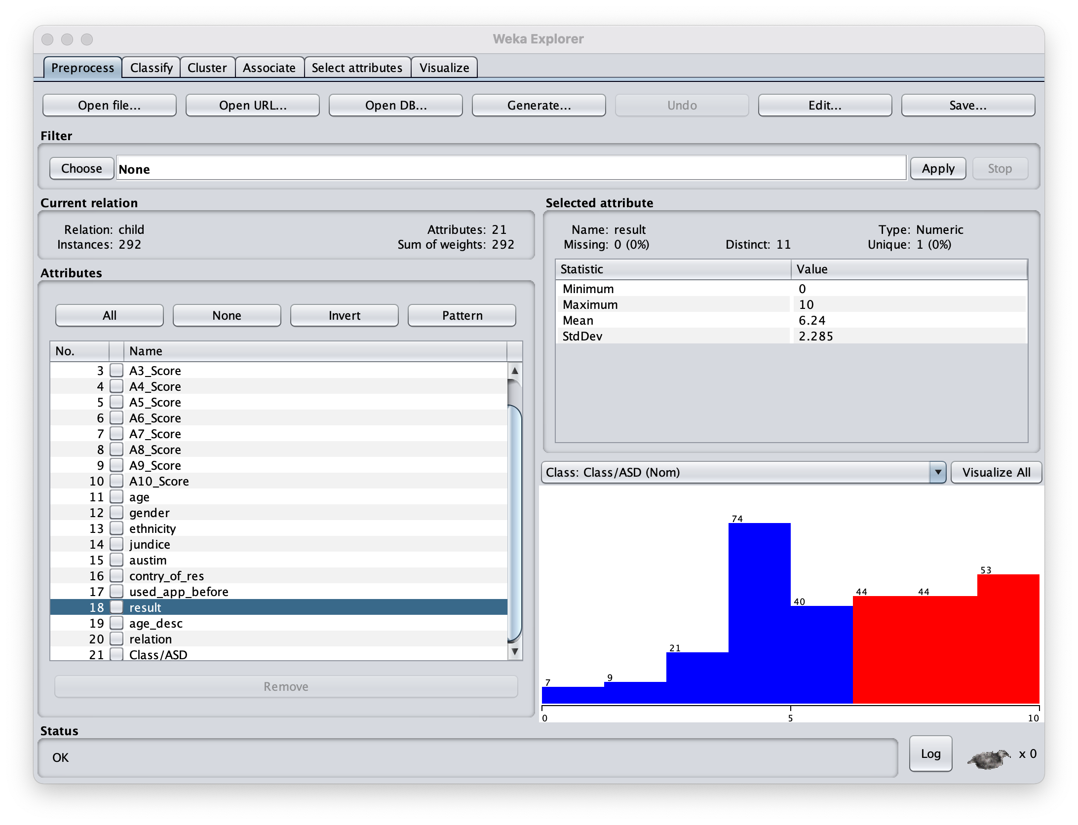
I’m too busy for EDA – just hit classify already
Screening Score | Integer | The final score obtained based on the scoring algorithm of the screening method used. This was computed in an automated manner
What are the important features:
The result variable is the study’s calculated score from 1-10 for predicting
Looks like anything above a 6 predicts Autism… what data did they use?
Let’s remove this feature. Choose -> filters -> unsupervised -> Remove

Slide 23
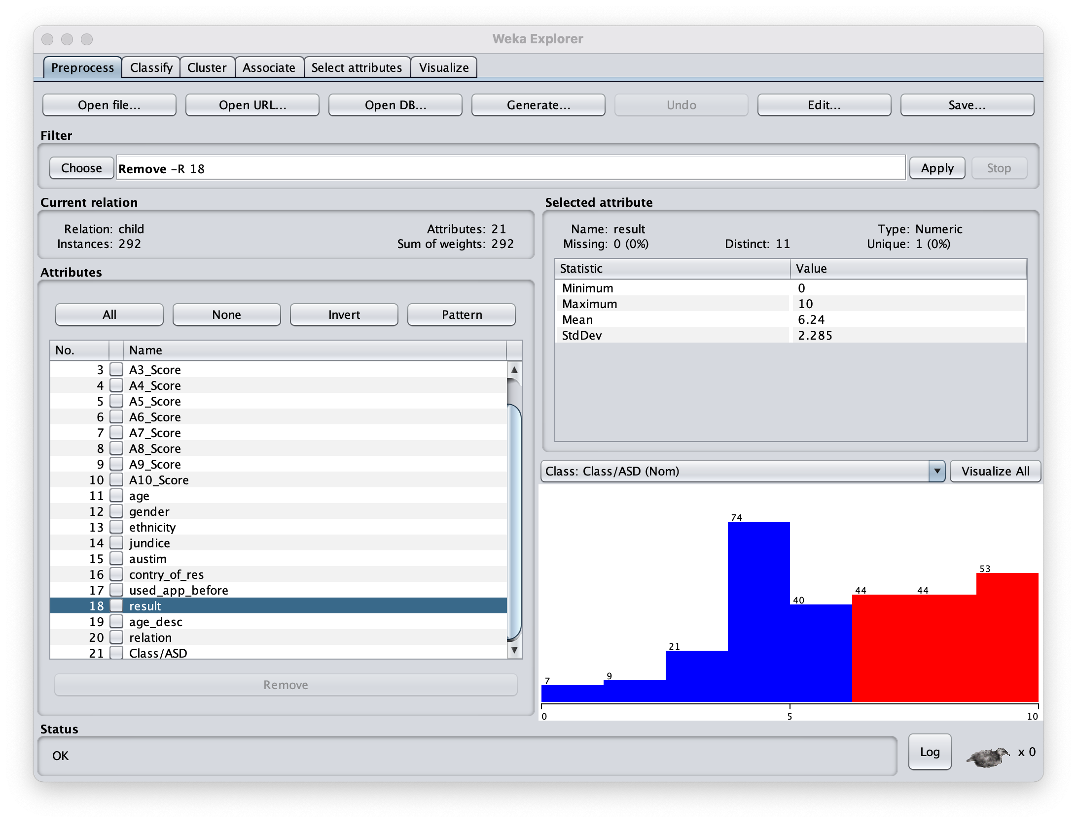
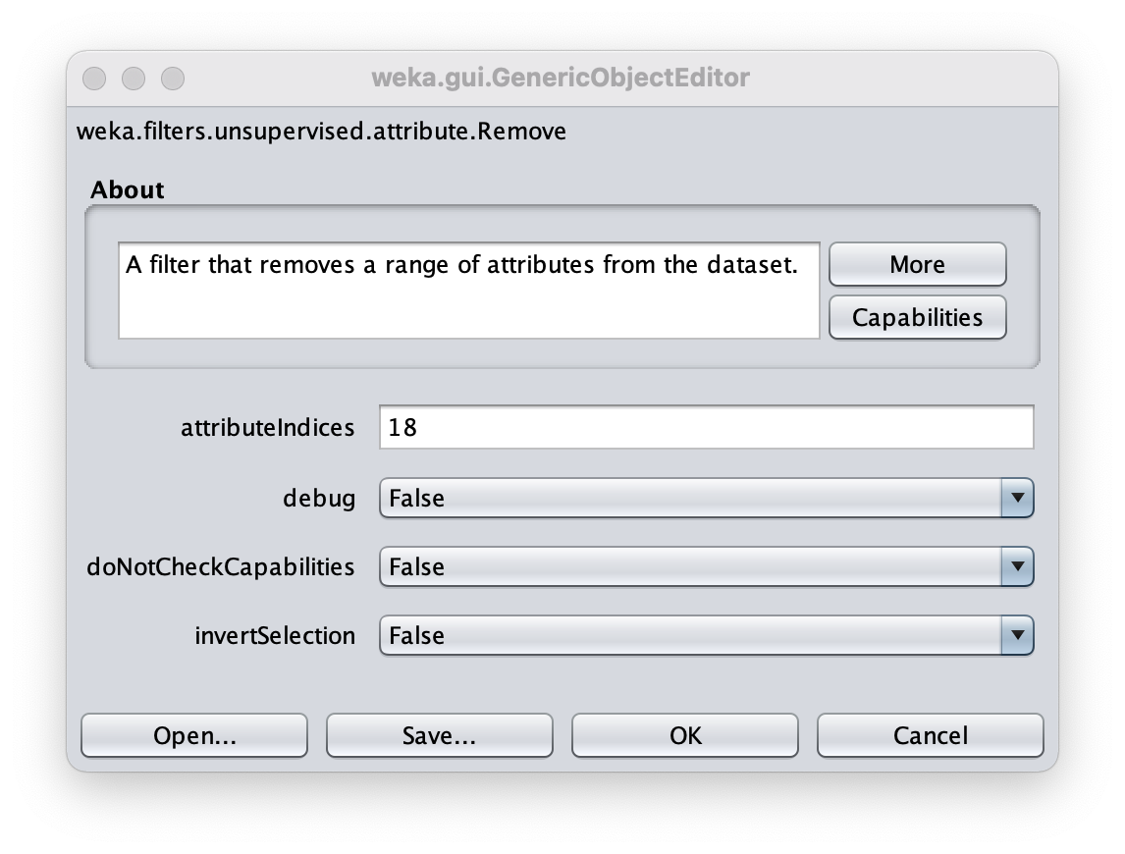
I’m too busy for EDA – just hit classify already
Screening Score | Integer | The final score obtained based on the scoring algorithm of the screening method used. This was computed in an automated manner
The result variable is the study’s calculated score from 1-10 for predicting
Looks like anything above a 6 predicts Autism… what data did they use?
Let’s remove this feature. Choose -> filters -> unsupervised -> Remove
Then, click ”Remove” to indicate we want the 18th attribute removed.
Finally, Click “Apply”.

Slide 24
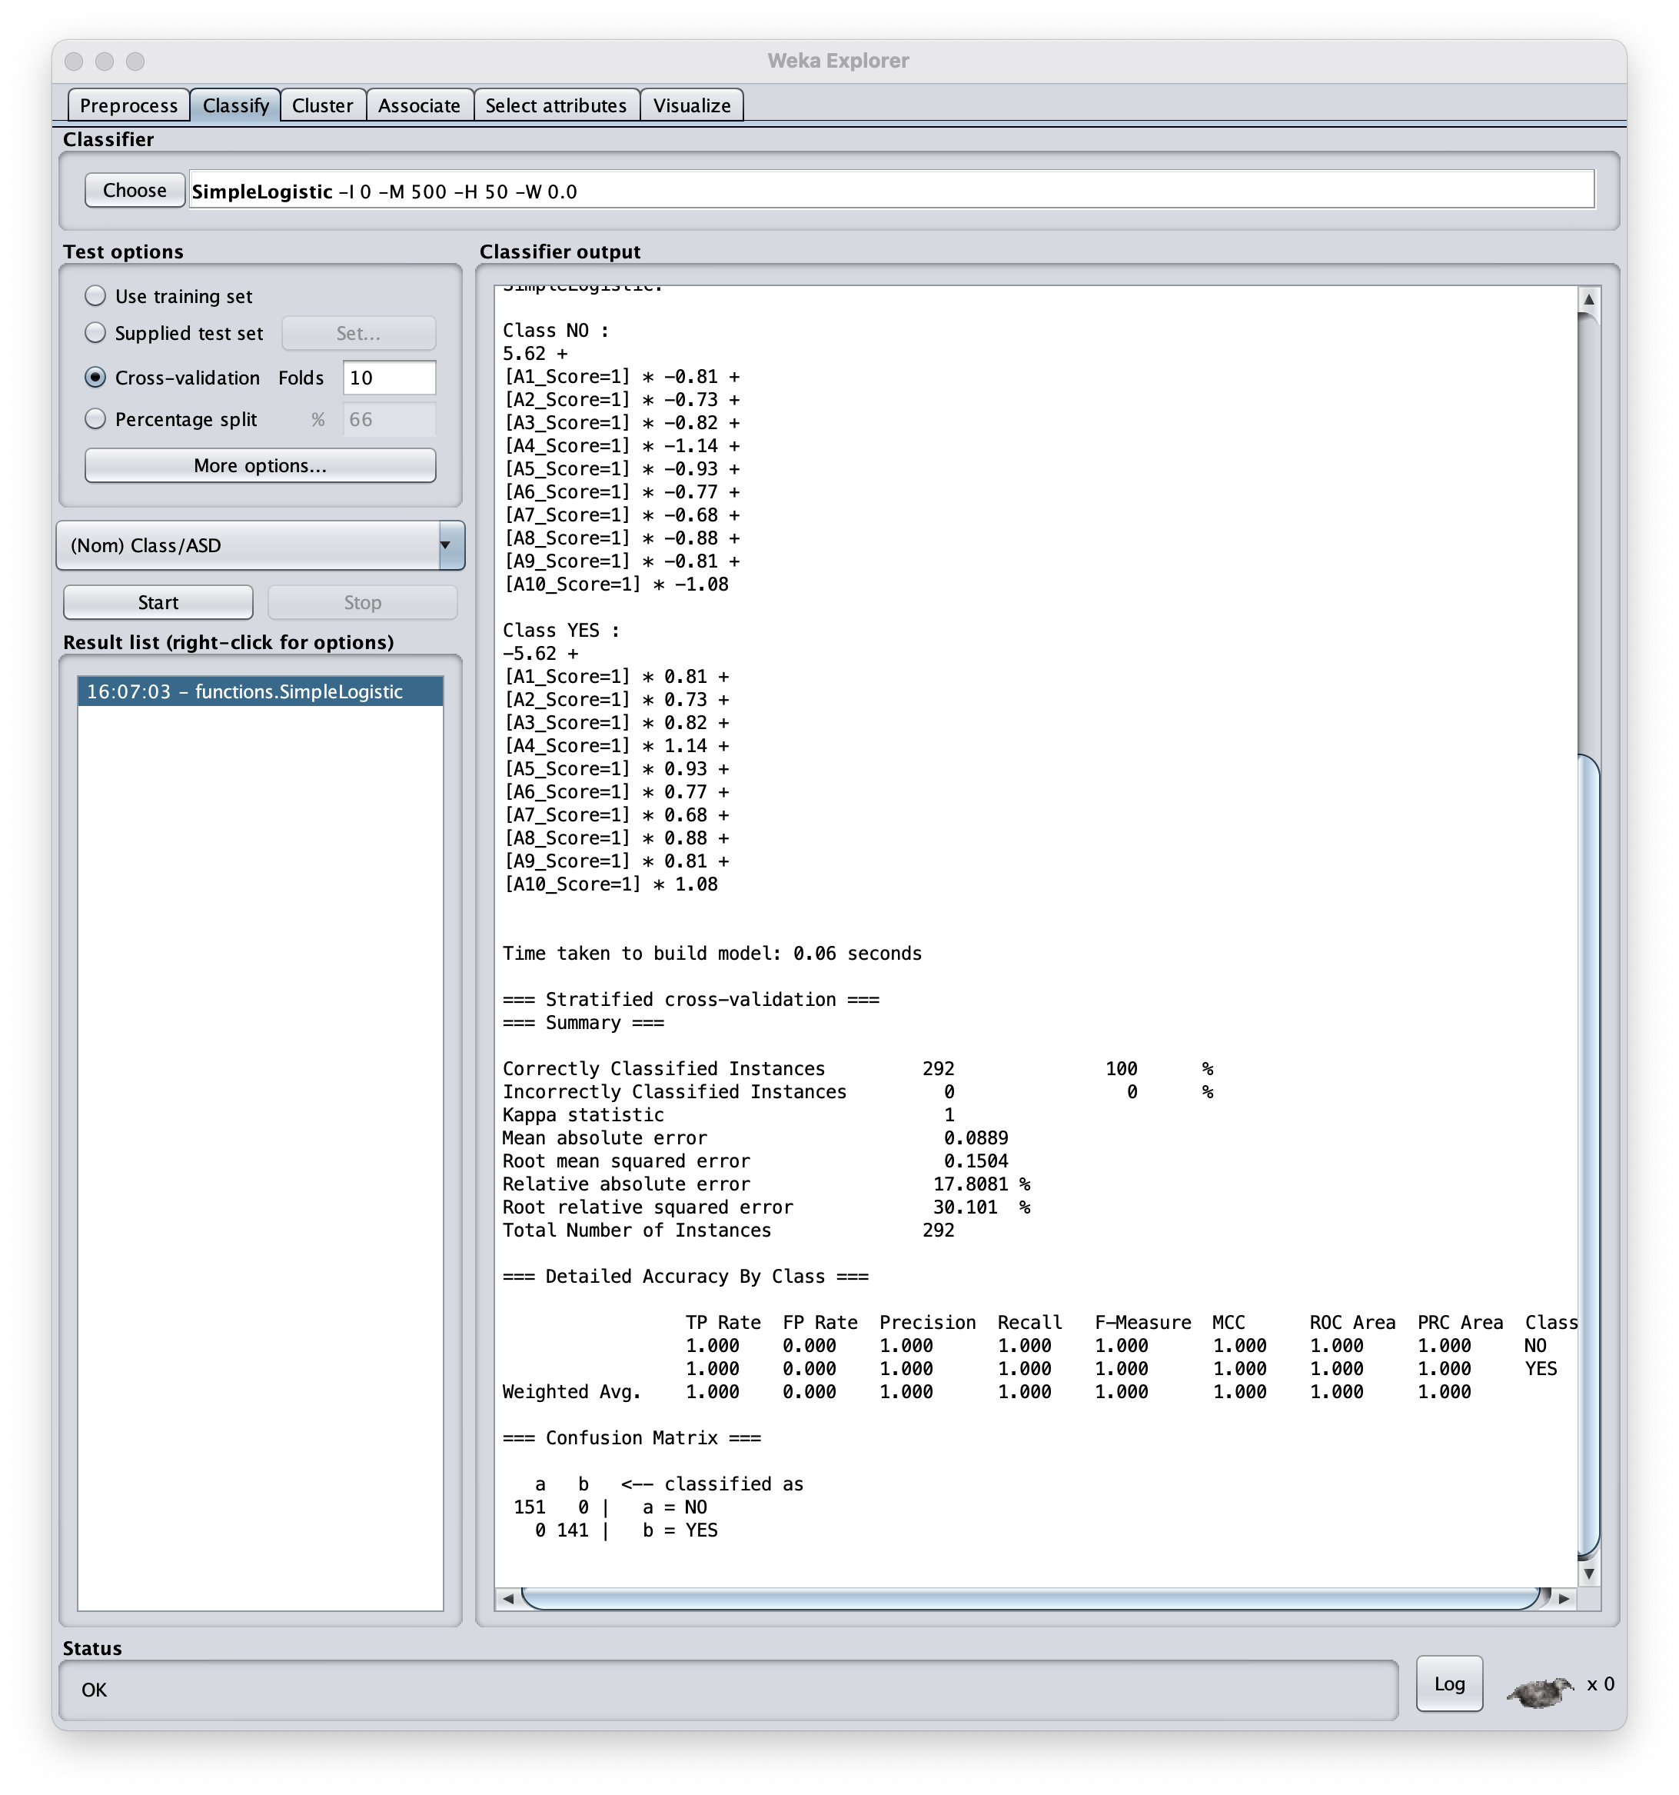
Now we can compare feature importance:
Still 100% accuracy?
Only the A1-10 questions survived the feature selection.
Demographics and other clinical variables not important to this model.
A4 score is most associated with Autism diagnosis.
A7 score is least associated with Autism.

Slide 25
Hypothesis Generation vs Hypothesis Testing
Exploratory Data Analysis
Statistical analyses aimed to discover important relationships in order to suggest hypotheses to test.
[ Histograms | Box Plots | Correlation Matrices | Principal Components ]
Statistical Hypothesis Testing
Statistical inference based on the predicted outcomes resulting from hypothesis relative to some alternative hypotheses. (How confident are we the observed outcomes result from an actual relationship rather than just by coincidence?)
[ Sensitivity | Specificity | P-values ]

Slide 27
Lew M.J. (2019) A Reckless Guide to P-values. In: Bespalov A., Michel M., Steckler T. (eds) Good Research Practice in Non-Clinical Pharmacology and Biomedicine. Handbook of Experimental Pharmacology, vol 257. Springer, Cham. https://doi.org/10.1007/164_2019_286

Slide 28
Am I p-hacking?
Most hypotheses wont be correct – That’s Science!
Projects tend to spill into each other
I can’t believe I used to think this. – says me two months later
Breaking into a new field - novice’s expertise grows faster than ever in career

Slide 29
Hypothesis test and Significance test
Neyman 1933 formalized the concept of power in terms of type 1 errors (FP) and type 2 errors (FN).
More N = better Stats, More N = More $$$
Long deep history has crystalized p>0.05 dogma.
P < 0.05 is arbitrary (but not unreasonable)
Frequentist approach can only reject the Null hypothesis.

Slide 30
Contradictory Instructions
Sometimes details of experiments cannot be reproduced 100%.
Judgments and debates on what is appropriate often driven by conviction rather than data.
P-value dogma -> conviction

Slide 31
P-values are not linear

Slide 32
Story telling and P-hacking

Slide 33
What to Do:
No legacy so rich as honesty - Shakespere
But, iteration is a necessary evil
Can’t I have both?

Slide 34
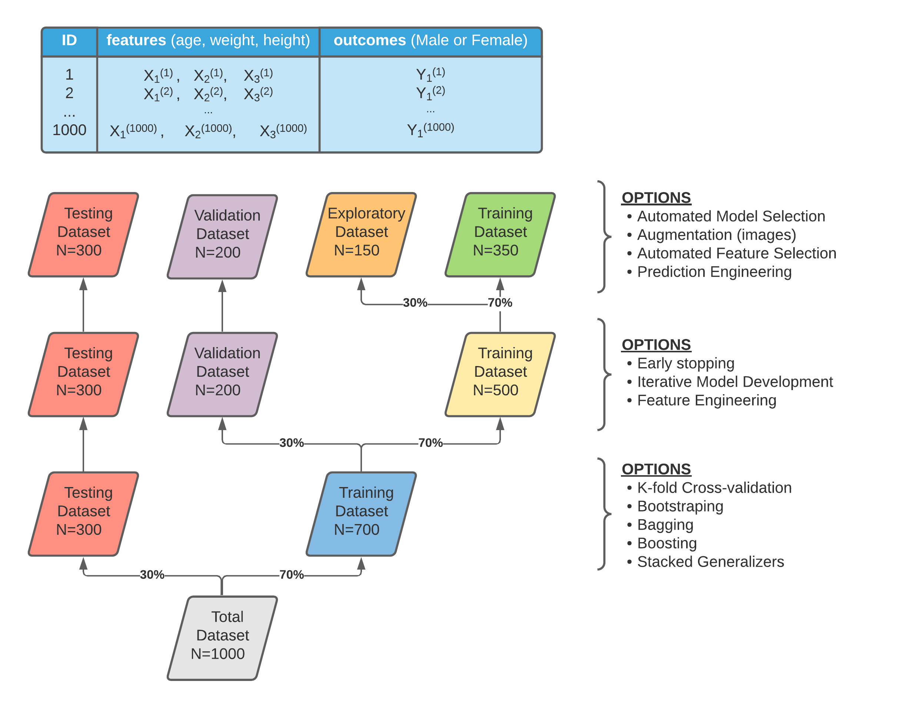
Partitioning: The 70-30 Rule
The size of your data (number of observational units) will constrain the level of partitioning that is appropriate.
The level of partitioning will determine the kind of analysis possible.
Define partitioning scheme before any analysis takes place.

Slide 35
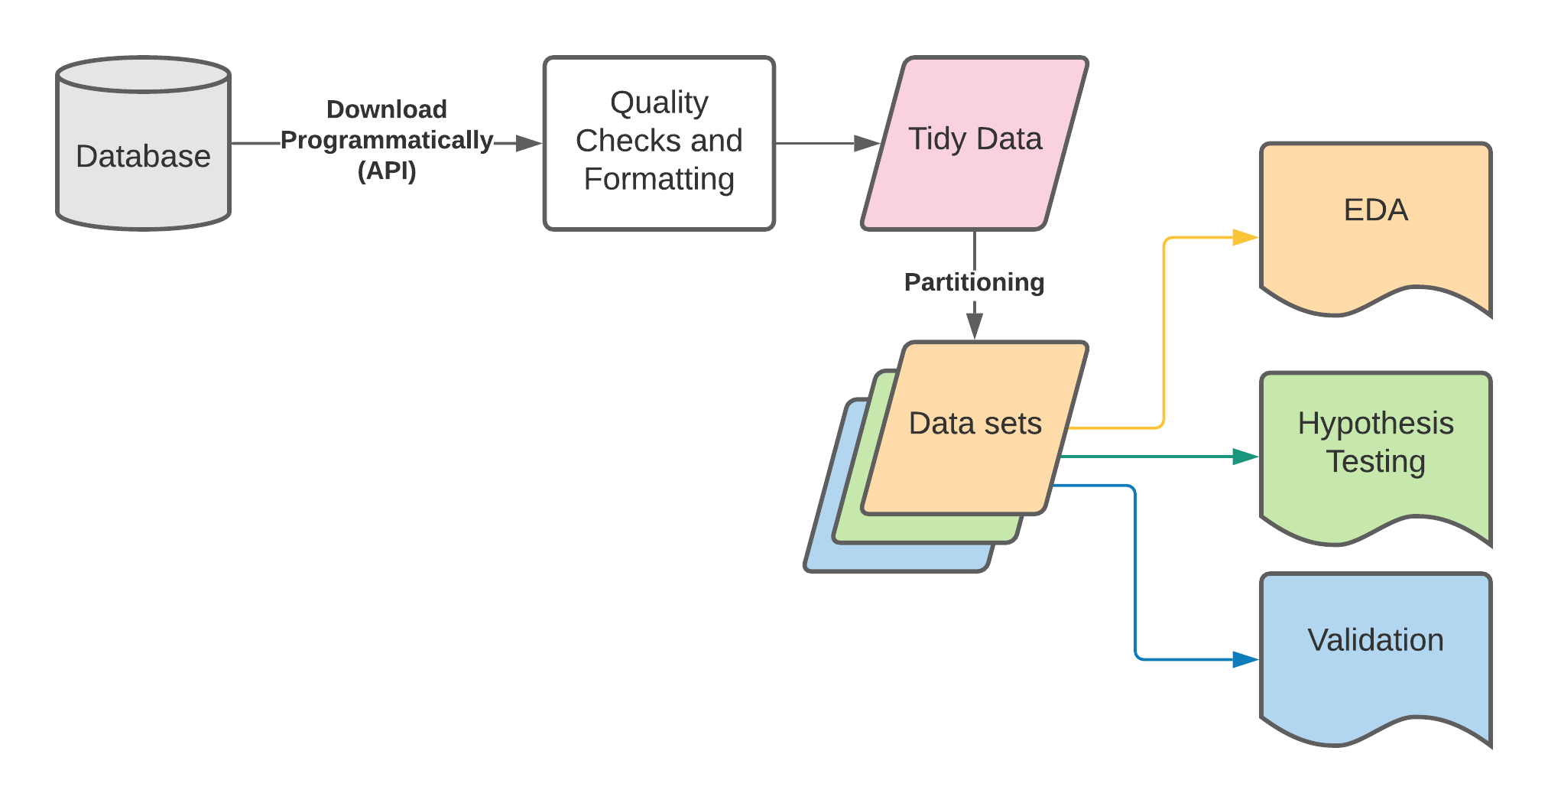
Maintaining Integrity

Slide 36
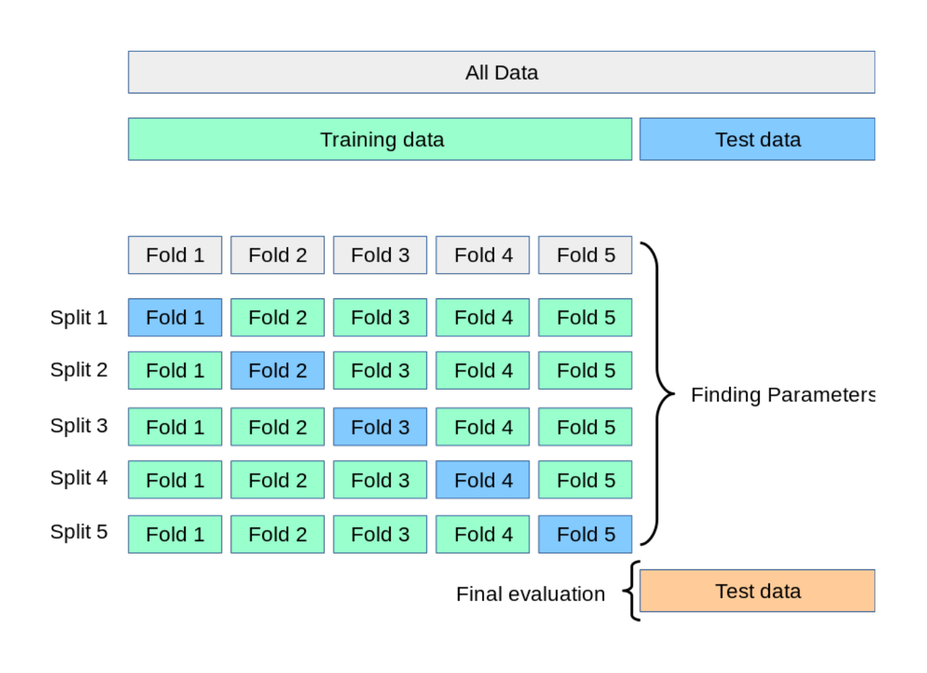
K-fold Cross Validation
How to use:
K models trained on N-(N/K) samples.
Each model makes N/K predictions and has unique error value (accuracy).
Demonstrate reproducibility in terms of mean and stdev of the K model errors.
Final model options:
New model trained using all training data.
Ensemble model that averages the K model predictions.

Slide 37
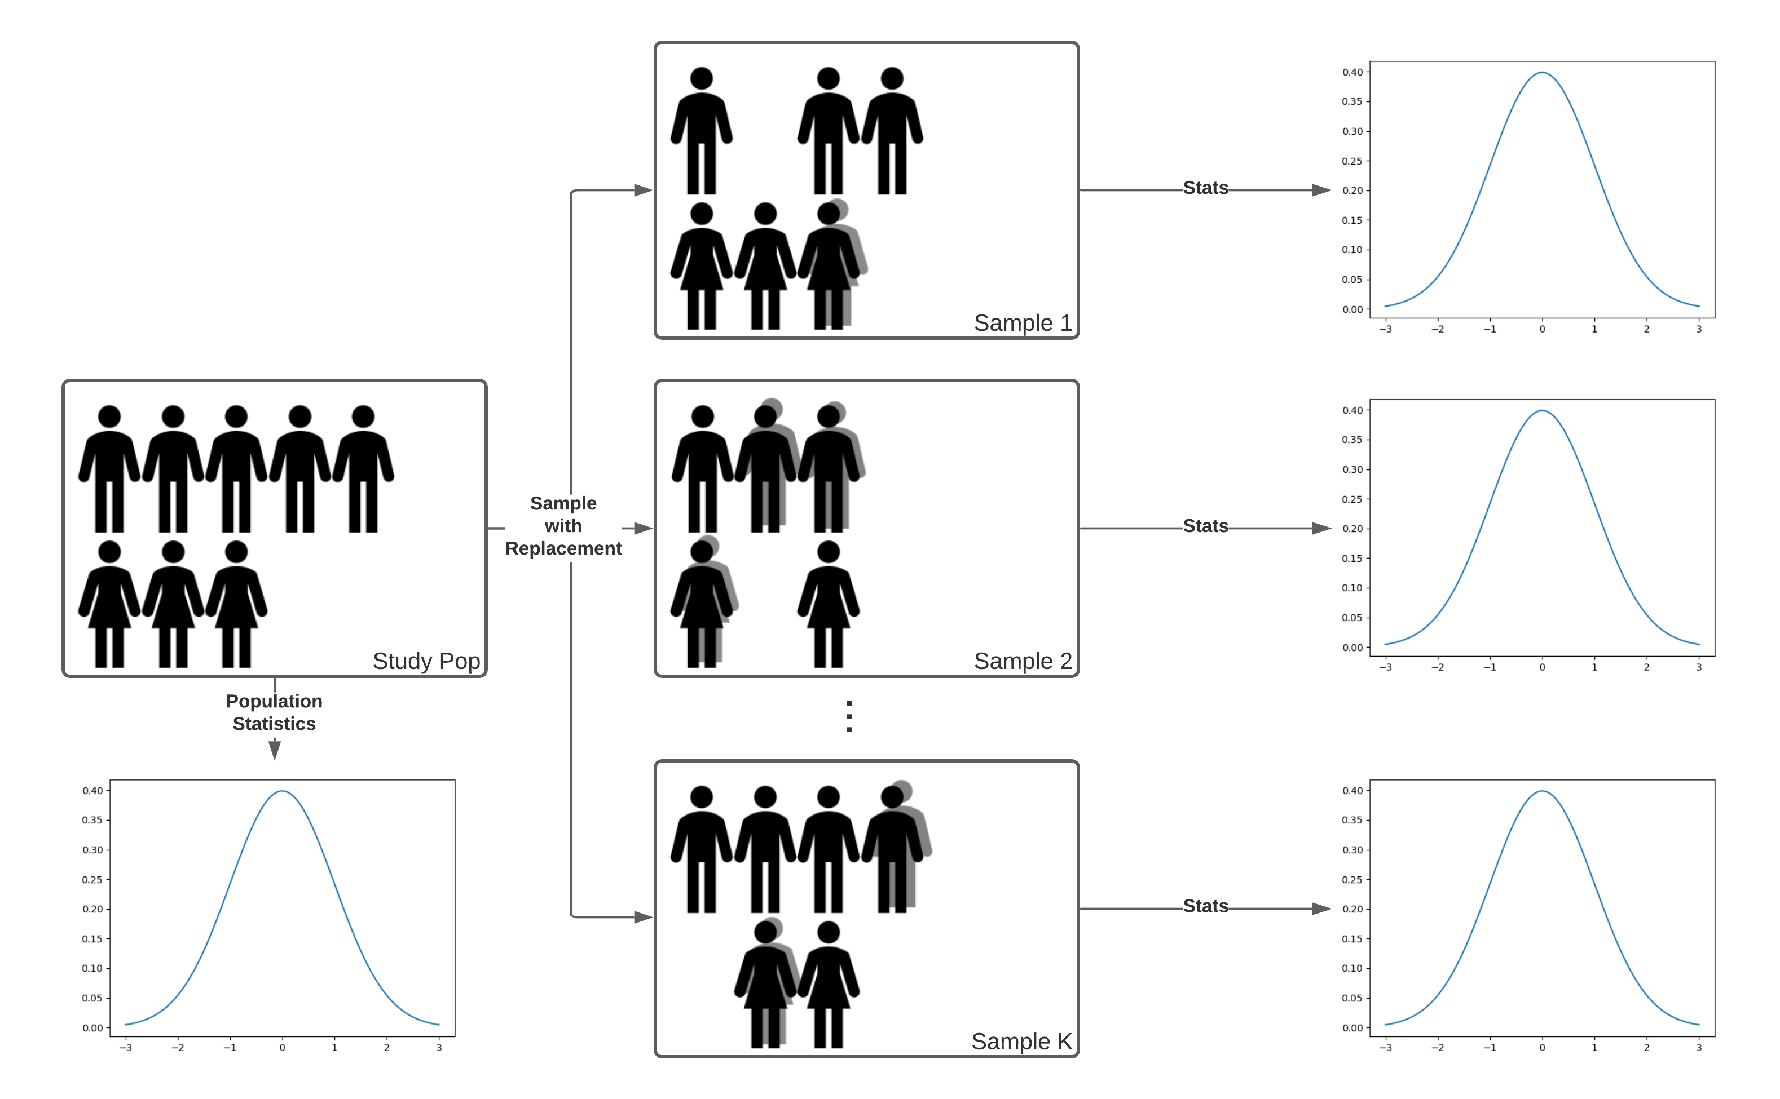
Bootstrapping
How to use:
Resample training data with replacement K times
Train K models each with unique predictions.
Use distribution of predictions to estimate properties of the original training set.
95% Confidence interval is the range of values between the 2.5% and 97.5% percentiles

Slide 38
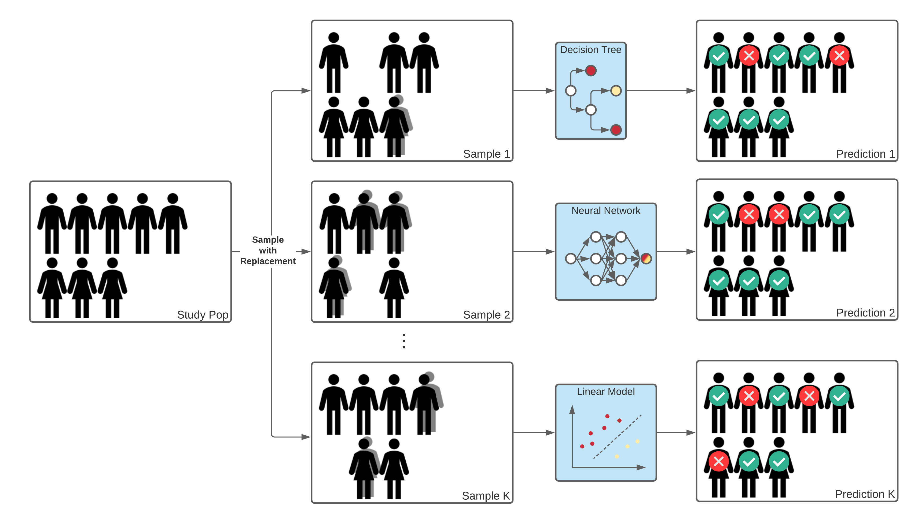
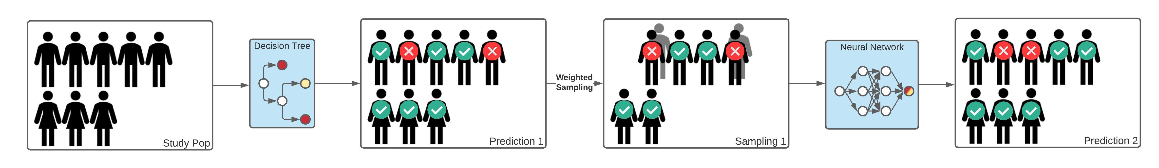
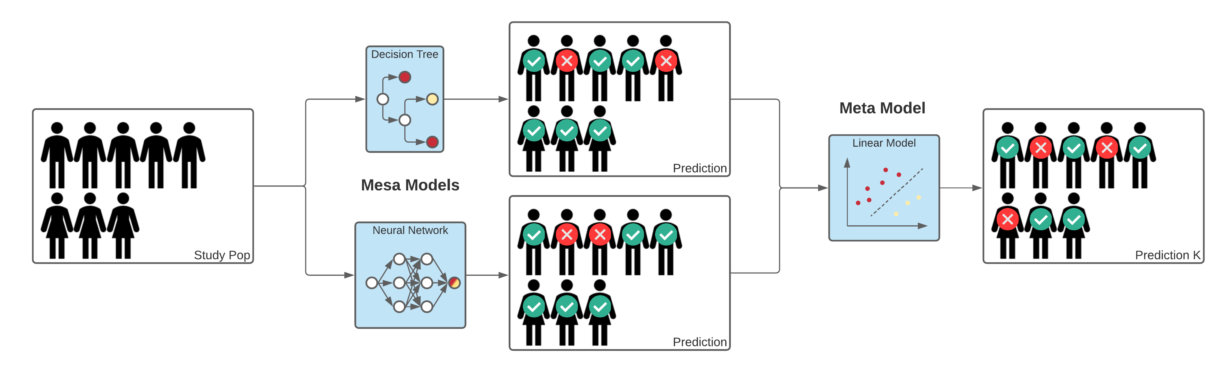
Ensemble Approaches
How to use:
Train set of models that are not necessarily of the same type
Aggregate results from different models.
Examples:
Bagging uses bootstrapped training data for each model
Boosting:
Sequentially train models
Sampling for next model is proportional to the prediction error of the previous.
Stacked Generalizer train model based on output of mesa models
a)
b)
c)

